Slide 1
Getting Started with C
Basic information
C-1 Start.pptx

Slide 2
The C Language
C developed in the late 1960’s
ANSI C – American National Standard Institute.
Established in 1989.
Allowed for portable code that can be transferred from one computer platform to another and still work.

Slide 3
A First Program, followed by descriptions of each line of code.

Slide 4
Hello World program
/*-----------------------------------------------------------*/
/* Ruthann Biel */
/* Lab 1 */
#include <stdio.h>
#include <stdlib.h>
int main(void)
{
printf(“\nLab 1 \n\n”);
printf(“Hi, Ruthann Biel \n\n”);
return(EXIT_SUCCESS);
}
/*-----------------------------------------------------------*/
The run will look like this:
Lab 1
Hi, Ruthann Biel

Slide 5
/*---------------------------*/
/* Ruthann Biel */
/* Lab 1 */
================================================
Examples of comments which can extend over several lines.
Can be at end of line of code also
e.g. printf(“\n”); /* print newline */
Alternative forms:
// Ruthann Biel
or
printf(“\n”); //print newline

Slide 6
Preprocessor Directives – give the compiler the
information it needs to run the program.
======================================
#include <stdio.h>
Stands for “STandarD Input Output”
Needed because we used:
printf
#include <stdlib.h>
Stands for “STandarD LIBrary”
Needed because we used:
EXIT_SUCCESS

Slide 7
int main(void)
must be in program
========================================
The first module of every C program is called “main”.
Some sources use “void main(void)” with no return.
It does not work with EXIT_SUCCESS, so
we will NOT use this style.

Slide 8
{
… braces surround BODY of the function
}
==================================
Later we will find additional uses for braces.

Slide 9
printf("\nLab 1 \n\n");
printf("Hi, Ruthann Biel \n\n");
==========================================
Examples of the printf function.
Each declaration and statement MUST end with
semicolon.
The format string or control string must be enclosed by
double quotes.

Slide 10
Side Note about Quotes in C
Power Point, by default, gives me the quotes one
would use for an essay.
Example: “….”
C requires quotes that go straight up and down
Example: "…."
Warning: The Power Point slides for this class do not
always have the proper quotes.

Slide 11
return EXIT_SUCCESS;
==================================
Shows a successful end of program
It is optional in ANSI C, but it is not optional
in this class.
FROM: /usr/include/stdlib.h
132 /* We define these the same for all machines.
133 Changes from this to the outside world should be done in `_exit'. */
134 #define EXIT_FAILURE 1 /* Failing exit status. */
135 #define EXIT_SUCCESS 0 /* Successful exit status. */

Slide 12
/*---------------------------------------------------------*/
/* Your name here */
/* Simple computation program */
#include <stdio.h>
#include <stdlib.h>
#include <math.h>
int main (void)
{ double x1=1, y1=5, x2=4, y2=7;
double side_1, side_2, distance;
printf("\nJane Smith\n\n");
side_1 = x2 - x1;
side_2 = y2 - y1;
distance = sqrt(side_1*side_1 + side_2*side_2);
printf("The distance between the two points "
"is %5.2f \n\n", distance); 3 . 6 1
return EXIT_SUCCESS; _ _ _ _ _
}
/*---------------------------------------------------*/

Slide 13
#include <math.h>
==================================
Additional Preprocessor Directive
It is necessary because the code used a math
function named sqrt.

Slide 14
double x1=1, y1=5, x2=4, y2=7;
double side_1, side_2, distance;
==================================
Variables declared with types
Some also initialized with values

Slide 15
side_1 = x2 - x1;
side_2 = y2 - y1;
distance = sqrt(side_1*side_1 + side_2*side_2);
==================================
Computational lines of code
using the math function named sqrt

Slide 16
printf("The distance between the two points "
"is %5.2f \n\n", distance);
==================================
The printing function is very different from Java.
We will spend time on it soon.
_ 3 . 6 1

Slide 17
The nitty-gritty details!

Slide 18
Variable & Identifier Name Rules:
- Must begin with an alphabetic character (a-z, A-Z)
or underscore ( _ ).
Digits are OK but not as first character.
Can be any length, BUT first 31 characters must be
unique.
C is case sensitive.
sum, Sum, SuM, and SUM are all different variables.
- A C Reserved Word or Keyword cannot be used as
an identifier.

Slide 19
ANSI C Reserved Words:
auto break case char
const continue default do
double else enum extern
float for goto if
int long register return
short signed sizeof static
struct switch typedef union
unsigned void volatile while

Slide 20
Examples of:
Valid Names Invalid Names
density 2sum
sum3 x&y
x_y x-y
x2_2 x2.2
Volume 1Volume

Slide 21
TYPES
Each variable must have a “type” which tells us the size,
precision, and accuracy the variable will be allowed.
The word “type” is an important buzz word in computers.
NOTE: Min & Max values VARY from system to system.
NUMERIC CHARACTER
Integers char
short string
int
long
unsigned
Floating point
float
double
long double

Slide 22
What comes after TRILLION?
Thousand
Million
Billion
Trillion
Quadrillion
Quintillion
Sextillion
Septillion
Octillion
Nonillion
Decillion
Notes:
CodeSystemLimits.c on Canvas in PowerPoint&Reference

Slide 23
Limits on Linux Coding
SIGNED INTEGERS:
short minimum: -32768
short maximum: 32767
int minimum: -2147483648
int maximum: 2147483647
long minimum: -9223372036854775808
long maximum: +9223372036854775807
UNSIGNED INTEGERS:
The lower limit for all unsigned integer is zero.
unsigned short maximum: 65535
unsigned int maximum: 4294967295
unsigned long maximum: 18446744073709551615
Notes:
CodeSystemLimits.c on Canvas in PowerPoint&Reference

Slide 24
Limits on My Dell Laptop
SIGNED INTEGERS:
short minimum: -32768
short maximum: 32767
int minimum: -2147483648
int maximum: 2147483647
long minimum: -2147483648
long maximum: 2147483647
UNSIGNED INTEGERS:
The lower limit for all unsigned integer is zero.
unsigned short maximum: 65535
unsigned int maximum: 4294967295
unsigned long maximum: 4294967295
Notes:
CodeSystemLimits.c on Canvas in PowerPoint&Reference

Slide 25
More limits on Linux Coding
FLOAT PRECISION:
float precision digits: 6
float maximum exponent: 38
float maximum: 3.402823e+038
double precision digits: 15
double maximum exponent: 308
double maximum: 1.797693e+308
long double precision: 18
long double maximum exponent: 4932
long double maximum: 1.189731e+4932

Slide 26
Limits on My Dell Laptop
FLOAT PRECISION:
float precision digits: 6
float maximum exponent: 38
float maximum: 3.402823e+038
double precision digits: 15
double maximum exponent: 308
double maximum: 1.797693e+308
long double precision: 18
long double maximum exponent: 4932
long double maximum: 3.205284e+317
Notes:
CodeSystemLimits.c on Canvas in PowerPoint&Reference

Slide 27
DECLARING VARIABLES:
All variables MUST be declared.
Examples:
int day;
int nickels, dimes;
float x;
float y1, y2;
double degrees;
double a, b, c;

Slide 28
ARITHMETIC OPERATORS & USE Intrinsic to C
Addition + a = b + c;
Subtraction – c = a – b;
Multiplication * d = x * y;
Division / x = d / y;
Modulus % z = f %g;
(or Mod)
29 % 5 → 4 which is the remainder from
the division of 29 & 5.

Slide 29
Shortened Operator and Arithmetic Precedence
Precedence Operator Associativity
1 ( ) inner-most first
2 unary + - right to left
3 binary * / % left to right
4 binary + - left to right
5 assignment
operator = right to left
Unary involves only one number with the operator.
Ex. -8 -x y++
Binary involves two numbers with the operator in between.
Ex. 9 + 8 or 9 * -8 or x / y

Slide 30
GETTING VALUES INTO VARIABLES:
int day = 21; } declarations
double y1 = 5.0, y2 = 10.0; }
OR
day = 6; }
y1 = 7.2; } assignments
y2 = 7.0; }
GENERAL FORM of Assignment:
variable_name = value;

Slide 31
Assignment Statements
Use the equal sign (=) to move a value from the right side
to the left side. (Same as in Java)
int i = 5;
Conceptually it acts like:
int i ← 5;

Slide 32
Order of Precedence
for Numeric Conversion:
Highest precedence: long double
double
float
long integer
integer
Lowest precedence: short integer

Slide 33
Constants
int a, b;
a = b + 6; /* the 6 is a constant integer */
double c, d;
c = d * 2.3; /* 2.3 is, by default, a double */

Slide 34
Mixing Numeric Types
int a = 7, b = 3, c;
c = a / b; → int / int
now c will have 2
since 7 / 3 is 2 r 1
INTEGER DIVISION TRUNCATES!!!
int a = 7, b = 3;
float c;
c = a / b; → int / int
so 7 / 3 yields 2 (as an int) but then
converts it to a float, so …
final value of c is 2.0

Slide 35
float a = 7, b = 3, c;
c = a / b; → float / float
so 7.0 / 3.0 → 2.333333
final value of c is 2.333333
float c;
c = 7 / 3.0; → int / double
double takes precedence
acts like 7.0 / 3.0 → 2.333333
final value of c is 2.333333

Slide 36
float a = 7.0, b = 3.0;
int c;
c = a / b; → float/float
so 7.0/ 3.0 → 2.333
final value of c is 2

Slide 37
To force the action we want, use CASTING.
int a = 7, b = 3;
float c;
c = (float) a / (float) b;
Note that the ( ) go around the type, not the variable.
General Form for CASTING:
(type) expression

Slide 38
Use of Precedence
If we do 2 + 4 * 6 – 3, there are FOUR ways it could be done.
2 + 4 * 6 - 3 2 + 4 * 6 – 3 2 + 4 * 6 – 3 2 + 4 * 6 - 3
2 + 24 - 3 6 * 3 6 * 6 – 3 2 + 4 * 3
26 - 3 18 36 - 3 2 + 12
23 33 14
Using Precedence and no parentheses, C would give you the first answer of 23.
To get the second answer of 18, do:
(2 + 4 ) * (6 -3)
To get the third answer of 33, do:
(((2 + 4) * 6) – 3) or (2 + 4) * 6 – 3
To get the fourth answer of 14, do:
2 + (4 * (6 – 3))

Slide 39
Beginning Precedence
Level 1 is highest. Level 4 is lowest.
Precedence Level | Symbol | Comments | Example
1 | ( ) | Done inner-most first. Then left to right | A + (C * D) + E
2 | + - | Positive & Negative Both unary. Done right to left | -A or +A
3 | * / % | Done left to right | A + C * D+ E
4 | + - | Add & Subtract Both binary Done left to right | A + C – D + E

Slide 40
Printing in Scientific Notation
X = 157.8926;
General Form:
[sign]d.ddde[sign]ddd
Specifer | Value Printer
%.3E | 1.579E+002
%.3e | 1.579e+002
%.2e | 1.58e+002
%g | 157.8926

Slide 41
Math Functions

Slide 42
Trigonometric Functions
System defined in math.h
Insert this line in the start of code: #include <math.h>
In C, trig functions operate in the radians mode.
sin(x) x in radians
cos(x) x in radians
tan(x) x in radians
asin(x) arcsine, -1 <= x <= +1
acos(x) arccosine, -1 <= x <= +1
atan(x) arctangent
atan2(y, x) arctangent of y / x

Slide 43
Trigonometric Functions
to convert to radians to degrees, or degrees to radians:
#define PI 3.14159
…
angle_degree = angle_radian * (180/PI);
angle_radian = angle_degree * (PI/180);

Slide 44
Math Functions
Intrinsic arithmetic operators (+ - * / %) are part of the core of C.
All the extra math functions are stored in:
#include <math.h>
All math functions are type double
fabs(x) absolute value
sqrt(x) square root, x >= 0
pow(x,y) exponentiations, x^{y}
error: if x = 0 & y <= 0
if x <= 0 & y not an integer
ceil(x) rounds up to next integer
floor(x) rounds down to previous integer

Slide 45
More Math Functions
All the extra math functions are stored in:
#include <math.h>
All math functions are type double ←
exp(x) ex (2.718282)
log(x) ln x, x > 0
log10(x) log10x, x > 0
abs(x) absolute value of integer x
in <stdlib.h>

Slide 46
Qualifier about math.h
We do not need to put this line
#include <math.h>
in every program. It is only needed when we are using a math function that is listed in the file math.h
When we add in math.h, we need to add to the compile line.
Example: gcc lab5.c -lm

Slide 47
Printing

Slide 48
GETTING THE VARIABLE on THE SCREEN:
General Form:
printf(format_string, argument_list);
The format_string has 3 parts:
characters
conversion specifiers
escape sequences

Slide 49
Getting The Variable On The Screen:
General Form:
printf(format_string, argument_list);
The format_string has 3 parts:
characters
conversion specifiers
escape sequences
printf("Height is %6.2f \n Length is %6.2f \n", height, length);
printf("Daniel\’s age is %i. \n", age);

Slide 50
GETTING THE VARIABLE ON THE SCREEN:
Example:
What I want to appear on the screen:
Daniel’s age is 23.
To get it:
int age = 23;
printf("Daniel\’s age is %d. \n", age);
or same result
printf("Daniel\’s age is %i. \n", age);
where
%d = conversion specifier
age = list of variables
(in this case, list has only one variable in it)

Slide 51
printf("Height is %6.2f \nLength is %6.2f \n", height, length);
on screen:
Height is 123.45
Length is 6.27
--------------------------------------------------------------------
%6.2 f 6 refers to width total
2 refers to precision / How many digits after the
decimal point
123.45 = 6 characters printed on the screen
--------------------------------------------------------------------
If we changed it to %8.2 f
8 refers to width total
2 refers to precision
bb123.45 = 8 characters printed on the screen

Slide 52
int group = 3;
float money = 78.25;
printf("Group %1i raised $%6.2f.\n", group, money);
Output:
Group 3 raised $ 78.25.

Slide 53
Print Conversion Specifiers, Integers
int, short %d, %i
short %hd, %hi
long %ld, %li
unsigned int %u
unsigned short %hu
unsigned long %lu

Slide 54
Print Conversion Specifiers, Floating Point
float, double %f floating pt.
%e %E scientific
%g %G %e or %E
whichever is shorter
long double %lf
%le %lE
%lg %lG
character %c
string %s

Slide 55
Examples of Conversion Specifiers for printf:
(b stands for Blank)
int i = 1, j = 29;
float x = 333.12345678901234567890;
double y = 333.12345678901234567890;
format exp how printed why
%d -j "-29” field length 3 by default
%010d i "0000000001" padded with zeros
%-12d j "29bbbbbbbbbb" left adjusted
%12o j "bbbbbbbbbb35" octal/right adjusted
%-12x j "1dbbbbbbbbbb" hex/left adjusted

Slide 56
Examples of Conversion Specifiers for printf :
(b stands for Blank)
int i = 1, j = 29;
float x = 333.12345678901234567890;
double y = 333.12345678901234567890;
format exp how printed why
%f x "333.123444" precision 6 by default
%.1f x "333.1" precision 1
%20.3f x "bbbbbbbbbbbbb333.123" right adjusted
%.9f y "333.123456789" precision 9
%-20.3e y "3.331e+02bbbbbbbbbbb" left adjusted

Slide 57
Summary: Conversion Specifiers for printf:
octal %o
hexadecimal %x
left adjusted %-
right adjusted %+
zero filled %0
Examples:
Left Adjusted Right Adjusted
123 123
4 4
67.8 67.8
5678 5678
Zero Filled
int x = 65;
Use a %05d & get: → 00065

Slide 58
Escape Sequences for printf:
\n Line feed or New Line
\a Alert. Beep. Bell.
\b Backspace.
\r Carriage return. Moves to start of line.
\ Concatenate lines.
\" Print double quotes.
\f Formfeed (ejects printer page)
\t Horizontal tab.
\v Vertical tab.
\\ Print backslash.
\’ Print single quote.
\? Print question mark.
%% Print percent character.

Slide 59
Reading values from the keyboard (scanf)

Slide 60
scanf function
( reads values from keyboard)
int count;
printf(“Enter the max count needed: “);
scanf("%i", &count);
%i - control string
& - address operator REQUIRED for scanf
count – identifier of variable

Slide 61
scanf function
With two variables:
float height, length;
scanf("%f%f", &height, &length);
NOTICE: No spaces,
no numbers,
no sizing,
just put the value in the address of the variable

Slide 62
scanf function
printf and scanf often appear in pairs:
int age;
printf("\nEnter your age: ");
scanf("%i", &age);
NOTE:
scanf does not like “\n” in the control string.
“\n” is an instruction aimed at the output,
not at input from the keyboard.

Slide 63
scanf is very picky!
1) You MUST use the “&” symbol.
2) You MUST be sure your conversion specifiers AGREE with
your variables.
double NEEDS %lf (that’s a lower case L)
int NEEDS %i or %d
float NEEDS %f
1 l

Slide 64
Constants - #define

Slide 65
CONSTANTS
Values that will not change during program.
Constants can be set up in a program using preprocessor
directives.
Examples:
#define PI 3.14159
#define MONTHS_IN_YEAR 12
General Form:
#define SYMBOLIC_NAME replacement

Slide 66
***WRONG WAY:
#define PI = 3.1415; // wrong
#define PI = 3.1415; // Everything after the name
// gets substituted
What will happen?
x = 2;
y = x * PI;
It will fill in as:
y = 2 * = 3.1415; ;
the whole phrase gets substituted!
and will NOT work as written.

Slide 67
ANOTHER WAY to do PI:
Use #include <math.h>
You may use these constants in my class,
but know that they are NOT ANSI standard!
/* Traditional/XOPEN math constants (double precison) */
#ifndef __STRICT_ANSI__
#define M_E 2.7182818284590452354
#define M_LOG2E 1.4426950408889634074
#define M_LOG10E 0.43429448190325182765
#define M_LN2 0.69314718055994530942
#define M_LN10 2.30258509299404568402
#define M_PI 3.14159265358979323846
#define M_PI_2 1.57079632679489661923
#define M_PI_4 0.78539816339744830962
#define M_1_PI 0.31830988618379067154
#define M_2_PI 0.63661977236758134308
#define M_2_SQRTPI 1.12837916709551257390
#define M_SQRT2 1.41421356237309504880
#define M_SQRT1_2 0.70710678118654752440
#endif

Slide 68
More Operators

Slide 69
More Operators: += -= *= /= %=
examples:
x = x + 5; x += 5;
y = y – 7; y -= 7;
z = z * 9; z *= 9;
a = a / 13; a /= 13;
b = b % 15; b %= 15;

Slide 70
Operator and Arithmetic Precedence
Precedence | Operator | Associativity
1 | ( ) | inner-most first
2 | + - Unary | right to left
3 | ++ -- Unary Postfix | left to right
4 | ++ -- Unary Prefix | right to left
5 | * / % Binary | left to right
6 | + - Binary | left to right
7 | = Assignment Operator | right to left

Slide 71
Operator and Arithmetic Precedence
Unary involves only one number with the operator.
Ex. -8 -x y++
Binary involves two numbers with the operator in between.
Ex. 9 + 8 or 9 * -8 or x + y

Slide 72
More on the printf statement

Slide 73
More on PRINTF Statements:
int a = 5, b= 9;
printf ("%i%i\n\n", a, b);
OUTPUT:
59
COMMENTS:
Oops, the numbers are bumped right against each other.

Slide 74
More on PRINTF Statements:
int a = 5, b= 9;
printf ("%ibb%i\n\n", a, b);
OUTPUT:
5bb9

Slide 75
Try it again: b - represents a blank
int a = 5, b= 9;
printf ("%2i%2i\n\n", a, b);
OUTPUT:
5 9
b5b9 /* this line showing where the blanks are */
COMMENTS:
Now the numbers have space between them.

Slide 76
Try it again: b - represents a blank
int a = 5, b= 9;
printf ("%3i%3i\n\n", a, b);
OUTPUT:
5 9
bb5bb9 /* this line showing where the blanks are */
COMMENTS:
Now the numbers have more space between them.

Slide 77
Another Problem:
int a = 5, b = 9;
int c = 223, d = 123;
printf ("%2i%2i\n\n", a, b);
printf ("%2i%2i\n\n", c, d);
OUTPUT:
5 9
223123
COMMENTS:
Not enough room for the three-digit numbers.
Also the numbers do not line up under each other.

Slide 78
Try it again: b - represents a blank
int a = 5, b = 9;
int c = 223, d = 123;
printf ("%4i%4i\n\n", a, b);
printf ("%4i%4i\n\n", c, d);
OUTPUT:
bbb5bbb9
b223b123
COMMENTS:
Now the numbers print with space between them.
Also the numbers now line up under each other.

Slide 79
More about the C Language

Slide 80
The C Language
Currently, the most commonly-used language for embedded systems
“High-level assembly”
Very portable: compilers exist for
virtually every processor
Easy-to-understand compilation
Produces efficient code
Fairly concise
Source: Embedded Systems Programming Languages
(http://www.eetimes.com/author.asp?section_id=36&doc_id=1323907
9/12/2014)

Slide 81
What is API?
Application Program Interface (API) is a set of routines, protocols, and tools for building software applications.
An API specifies how software components should interact and APIs are used when programming graphical user interface (GUI) components.

Slide 82
Why C?
Many situations where it is only language or system available
Small, embedded systems, instrumentation, etc.
Many “low-level” situations that don’t have support for “high-level” languages
Operating systems, real-time systems, drivers
On Unix-like systems, that API is usually part of an implementation of the C library (libc), such as glibc, that provides wrapper functions for the system calls.

Slide 83
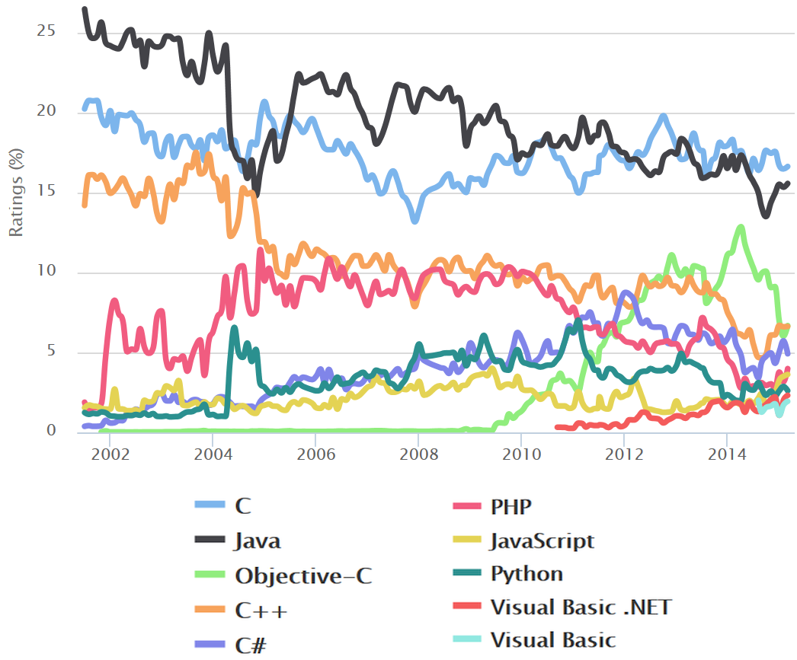
Languages Popularity
Source: https://en.wikipedia.org/wiki/TIOBE_index

Slide 84
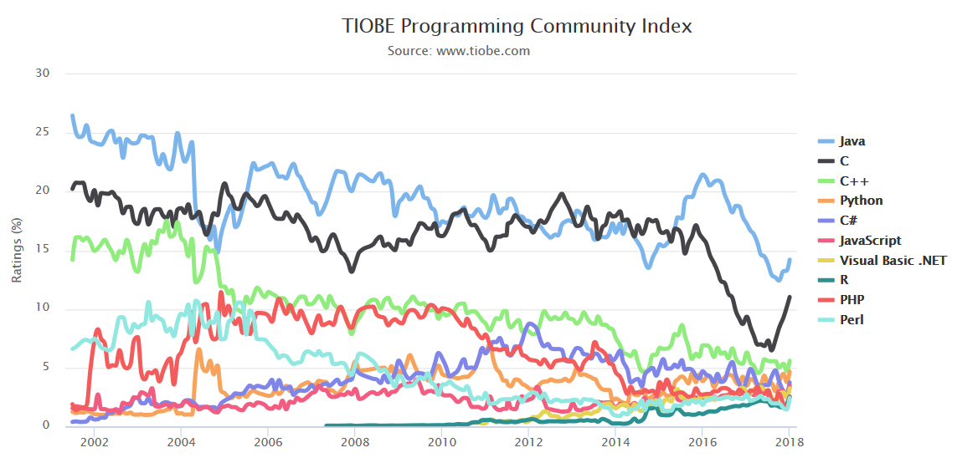
For newest data → https://www.tiobe.com/tiobe-index/

Slide 85
Getting Started
Basic information
C-1 Start.pptx
THE END

